Slide 1
Vault Navigation
Vault-API-Samples | Thin Client | Vault Explorer

Slide 2
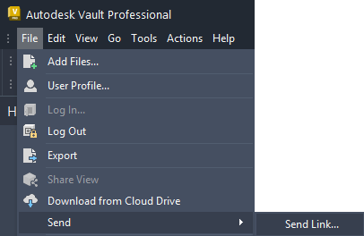
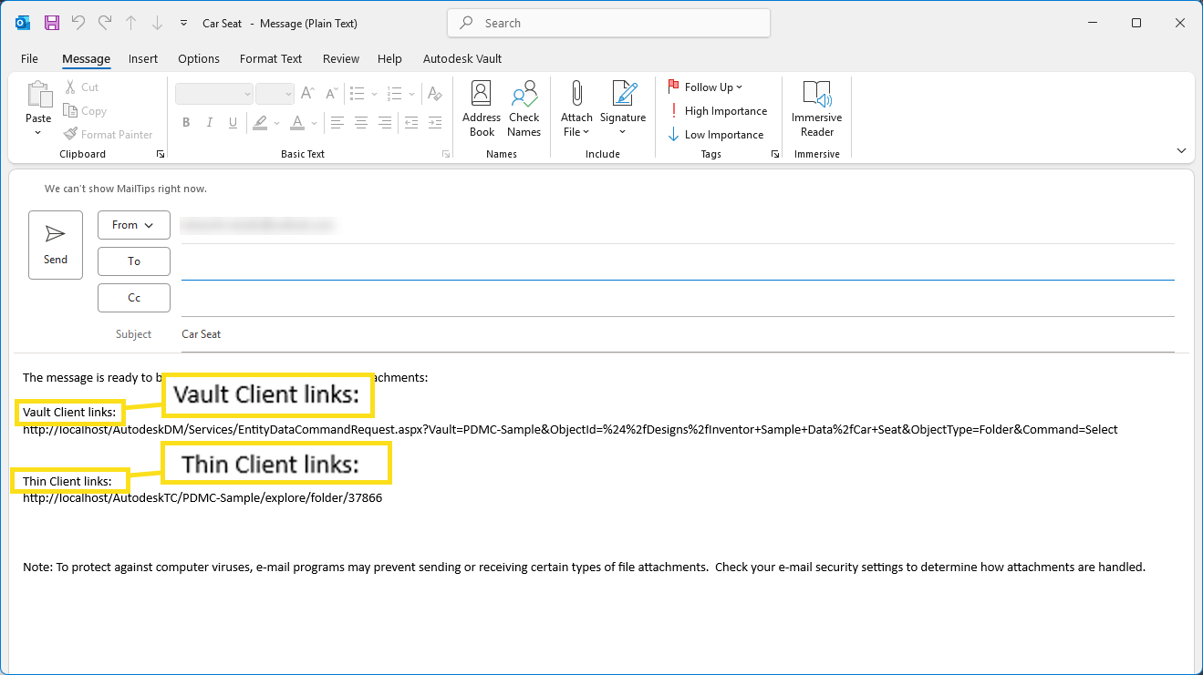
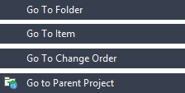
Vault Navigation
Vault-API-Samples
Go To Thin Client – Link
Go To Vault Explorer – Link
Go To Vault Entity – Internal Navigation

Slide 3
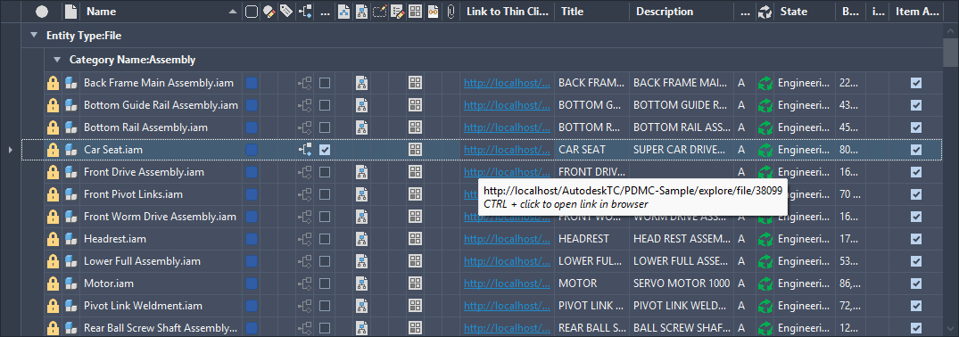
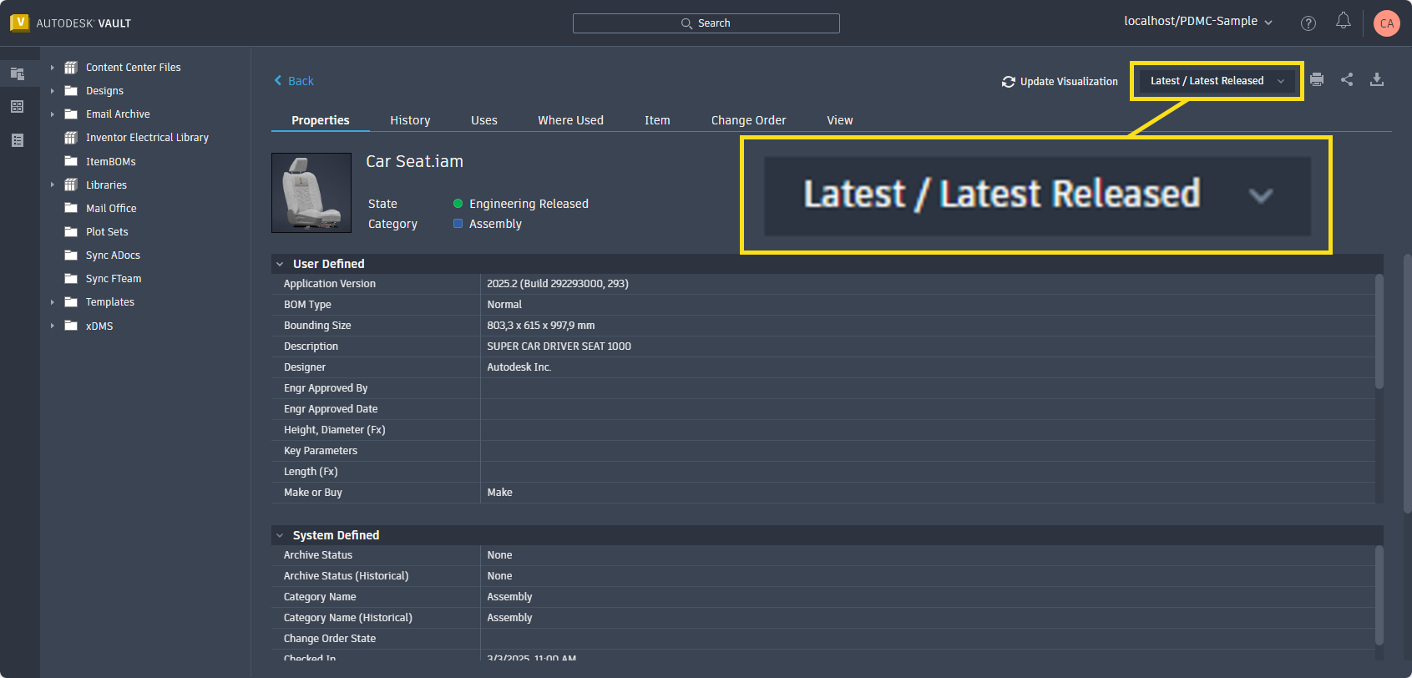
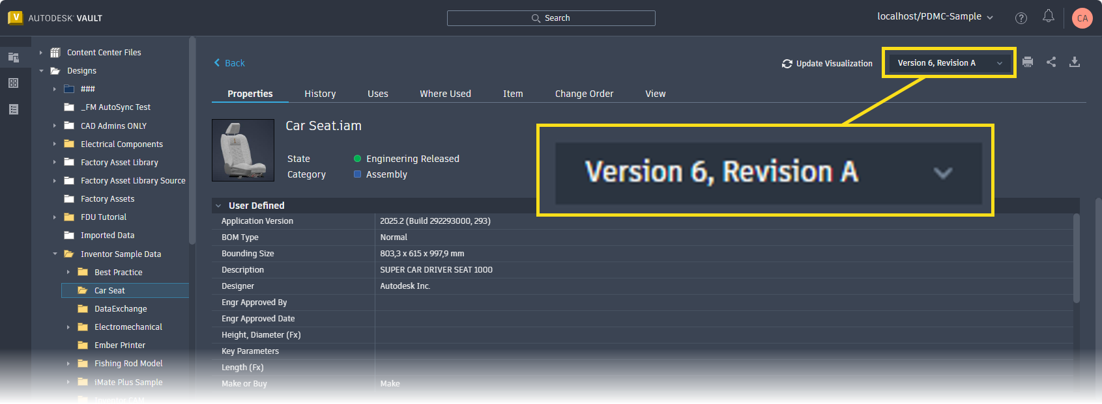
Thin Client Links
Display Thin Client Link in Vault Explorer UI
Vault API – Create TC Links
Thin Client Navigation – Main View
Thin Client Navigation – History View
Supported Entities
Folder | File | Item | Change Order
Requirements:
Vault API / Thin Client 2022 and newer
Thin Client – Main View
Thin Client – History View

Slide 4
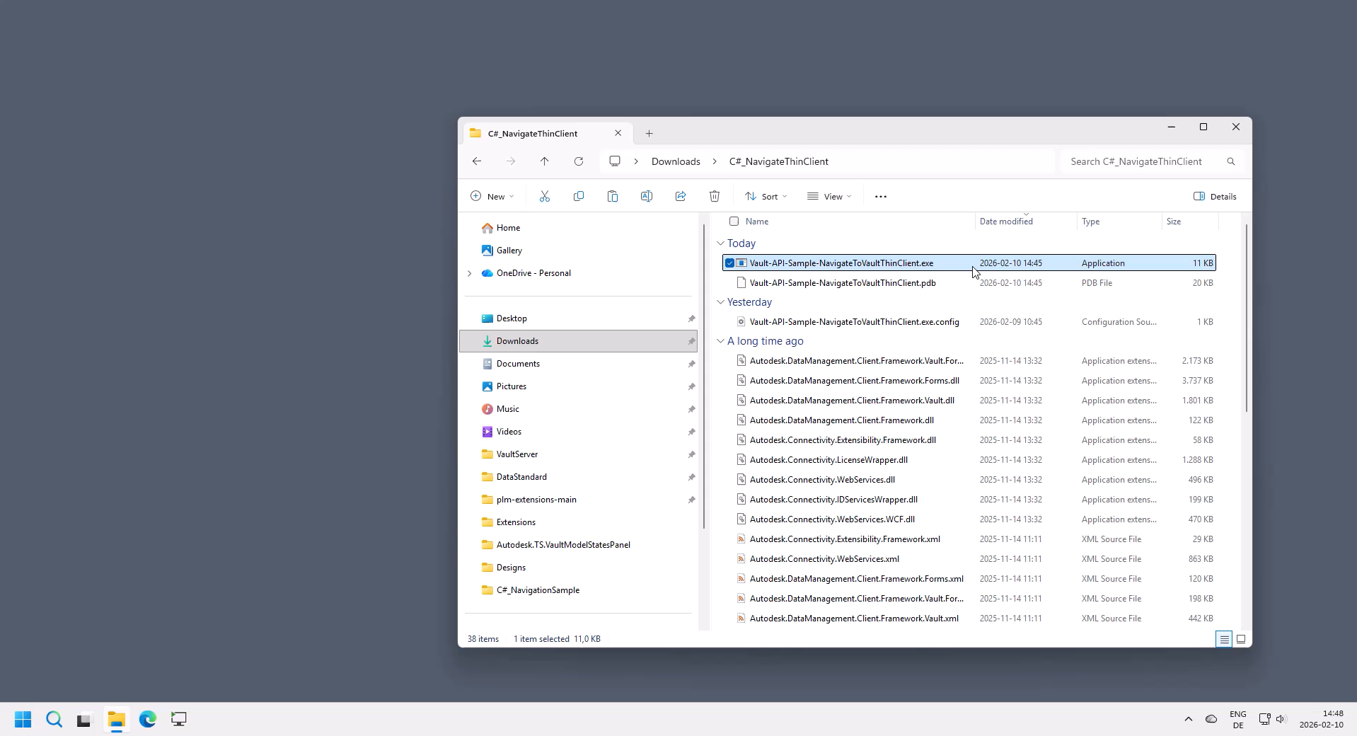
Thin Client Links
Vault API – Create Thin Client Links | URL Syntax
General Parameters:
{server} = IP address or server name
{vaultName} = Name of the target Vault
Parameters for FOLDER entities
{id} = Folder.Id
http://{server}/AutodeskTC/{vaultName}/explore/folder/{id}
Parameters for FILE entities:
{masterId} = File.MasterId
http://{server}/AutodeskTC/{vaultName}/explore/file/{masterId}
Parameters for FILE Version entities:
{id} = File.Id = iteration id/file version
http://{server}/AutodeskTC/{vaultName}/explore/fileversion/{id}
Parameters for ITEM entities:
{masterId} = Item.MasterId
http://{server}/AutodeskTC/{vaultName}/items/item/{masterId}
Parameters for ITEM Version entities:
{Id} = Item.Id
http://{server}/AutodeskTC/{vaultName}/items/itemversion/{Id}
Parameters for CO entities:
{EntityMasterId} = ChangeOrder.EntityMasterId
http://{server}/AutodeskTC/{vaultName}/changeorders/changeorder/{EntityMasterId}
Sample code to navigate all entity types:
Vault-API-Sample: Navigate To Vault Thin Client
Video:

Slide 5
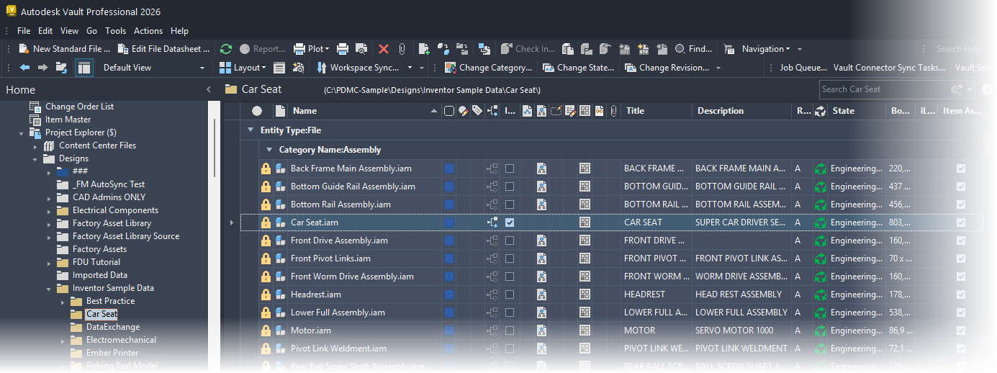
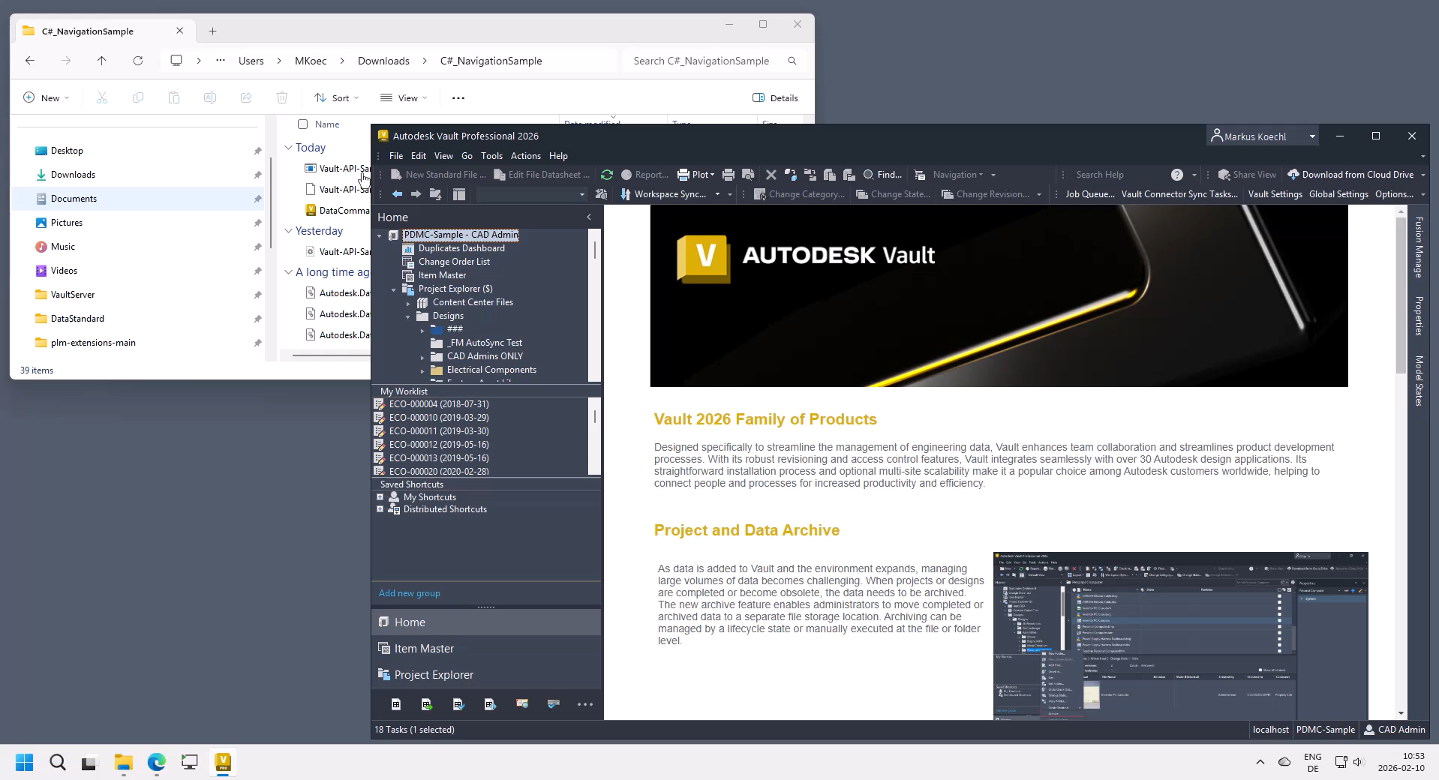
Vault Explorer Links
Vault API – Create Thick Client Links
Vault Client Navigation – Main View
Thick Client links support navigating the main view/latest version only
Supported Entities
Folder | File | Item | Change Order | Custom Object
Requirements
Allow to download and open *acr files if using Web Browser
Leverage custom programming to execute Connectivity.VaultPro.exe with argument = acr file
Sample code to navigate all entity types:
Vault-API-Sample-NavigateToVaultExplorer
Video:

Slide 6
Vault Explorer Links
Vault API – Create Thick Client Links | URL Syntax
General Parameters:
{server} = IP address or server name
{vaultName} = Name of the target Vault
Parameters for FOLDER entities
{folderFullName} = Folder.FullName =
http://{server}/AutodeskDM/Services/EntityDataCommandRequest.aspx?Vault={vaultName}&ObjectId={folderFullName}&ObjectType=Folder&Command=Select
Parameters for FILE entities:
{parentFolderFullName} = path from folder root to file’s folder
{fileName} = File. file name including extension
http://{server}/AutodeskDM/Services/EntityDataCommandRequest.aspx?Vault={vaultName}&ObjectId={parentFolderFullName}/{fileName}&ObjectType=File&Command=Select
Parameters for ITEM entities:
{number} = Item Number
http://{server}/AutodeskDM/Services/EntityDataCommandRequest.aspx?Vault={vaultName}&ObjectId={number}&ObjectType=ItemRevision&Command=Select
Parameters for Change Order entities:
{number} = Change Order Number
http://{server}/AutodeskDM/Services/EntityDataCommandRequest.aspx?Vault={vaultName}&ObjectId={number}&ObjectType=ECO&Command=Select

Slide 7
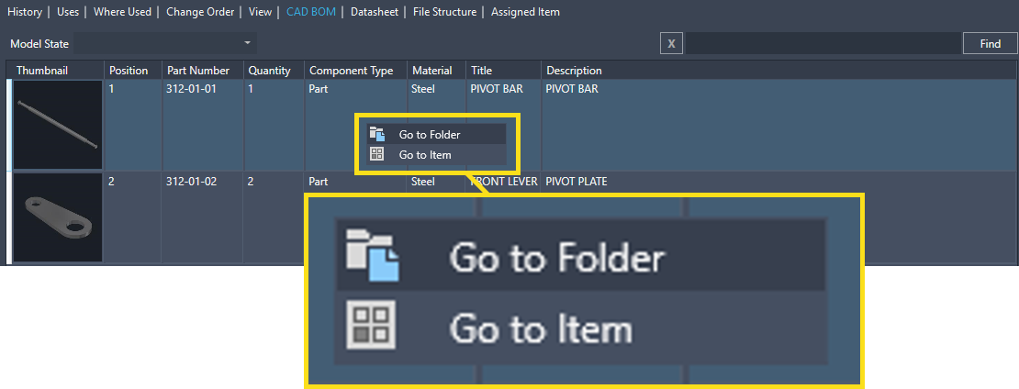
Vault Explorer
Vault API – Go To Entity
Go To Entity = Vault Client Navigation
API to leverage navigation in Vault Client Extensions
Navigates to entity in main view
Requirements:
Vault API 2026 and newer
Code Samples:
Vault SDK – HelloWorld
Data Standard extended configuration sample
VDS-MFG-Sample Configuration 2026

Slide 8
In any case, all binaries, configuration code, templates and snippets of this slide deck are of "work in progress" character.
This also applies to GitHub "Release" versions.
Neither Markus Koechl, nor Autodesk represents that these samples are reliable, accurate, complete, or otherwise valid.
Accordingly, those configuration samples are provided as is with no warranty of any kind and you use the applications at your own risk.

Slide 9

Technology Options
Inventor iLogic
Notes:
Technology Options

Slide 10
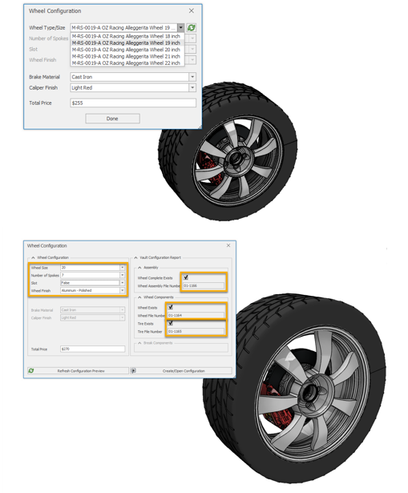
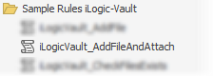
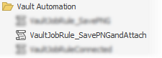
Inventor iLogic
iLogic-Vault Extensions
Inventor iLogic offers an extensibility and automation API
Technical Sales combined iLogic API and Vault API and built wrappers for
iLogic-Vault
iLogic-VaultInventorServer

